Slide 1
MY AGED CARE - Changes to the PROVIDER PORTAL USER INTERFACE
July 2017

Slide 2
Purpose of presentation
To provide an overview of the changes to the Provider Portal user interface (compared to the current interface)
To demonstrate some key changes/improvements for users
To ready users for the change on 24 July 2017.
Note:
All screenshots used show test data and do not reflect real client data or timeframes
There may be further updates to functionality prior to the Release
Changes will also be made to the Assessor Portal.

Slide 3
Why make changes to the user interface?
To make the portal easier to use
To introduce a cleaner, more modern user interface
To enable a consistent user experience across all screens
To have a responsive application that can work across various browsers and devices, and is optimised for different screen resolutions.
Why now?
This is in addition to the full number of changes included in the release
While it’s a large improvement for users, it’s a small IT change
There will be no impact to the performance of the system.

Slide 4
Provider Portal – Home Page
CURRENT INTERFACE
NEW INTERFACE

Slide 5
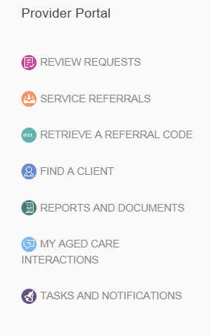
Team Leader / Staff – Find a Client
Hint: When your screen size is small (or minimised), a menu button appears in the top left for you to navigate to the various tiles that display on your home page.

Slide 6
Team Leader – Incoming Referrals (card view)
Hint: The expanded card view now appears as a pop-up modal. This means there is more space to display referral cards. If you wish to exit the expanded card view without taking an action, you can press ‘Esc’ on your keyboard.

Slide 7
Team Leader – Incoming Referrals (list view)
Hint: The sort/filter options are collapsed by default in list view. Selecting this button will show you the options.

Slide 8
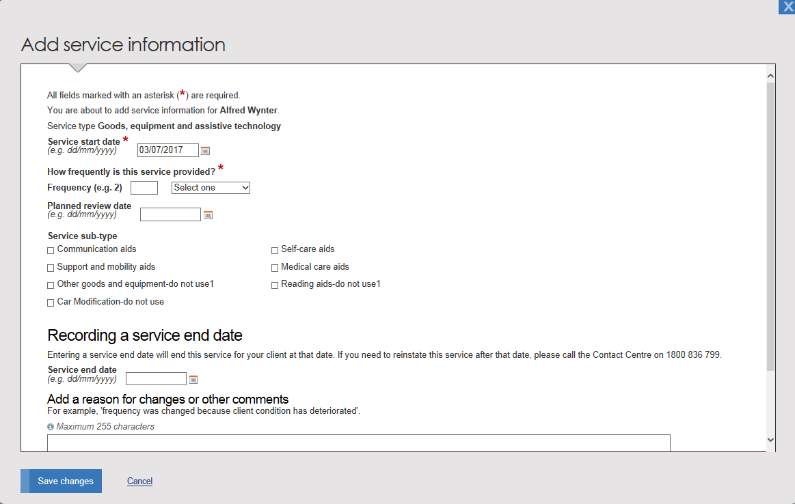
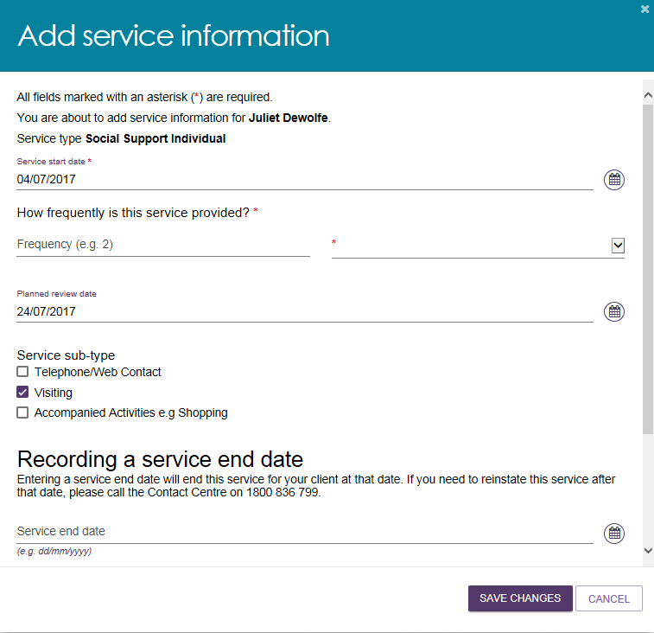
Team Leader / Staff – Enter Client Service Information
Hint: To populate text or date fields, you will need to select the field title, which will minimise upon selection.

Slide 9
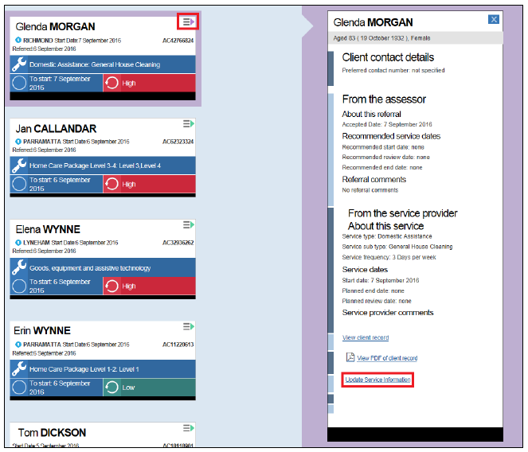
Team Leader / Staff – Services in place
Hint: Where a page has multiple items that extend beyond the length of your screen, as you scroll a purple button with an arrow will appear which, when selected, will take you to the top of the page. You could also use the CTRL+Home shortcut to take you to the top of the page. This button will appear across all pages on the portal (e.g, client record, referral queue etc).

Slide 10
Team Leader / Staff – View Client Record – Client Details
Hint: There is now a ‘Tasks and Notifications’ tab on a client’s record. This will display all tasks and notifications relevant to the client, so they can be actioned or viewed at the same time.

Slide 11
Team Leader / Staff – View Client Record – Plans
Hint: Many of the previous hyperlinks now display as buttons.

Slide 12
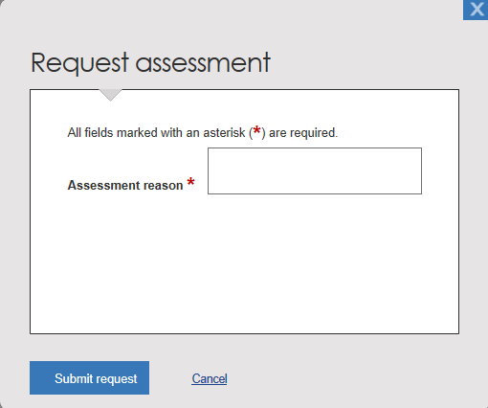
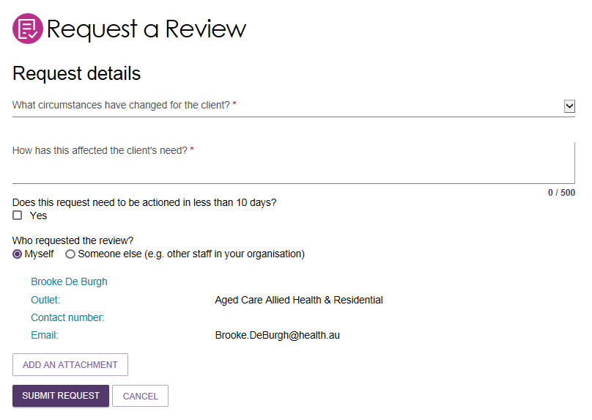
Team Leader / Staff – Support Plan Review Request
Hint: You are now able to request a review of a client’s support plan from the top of each tab in the client record or on the client’s accepted referral.

Slide 13
All users – Tasks and Notifications
Hint: From the task or notification tab, you will now be able to directly navigate to the section in the portal where you can view more information about or action the task or notification.

Slide 14
Administrator – Outlet Administration
Hint: When your screen size is large, the tabs appear at the top of the page so you can navigate to the various tiles that display on your home page. The menu button is also available.

Slide 15
Administrator – Outlet administration – Add Services
Hint: Symbols (rather than hyperlinks) are used to reflect the actions/changes you can make (e.g. view, edit, remove).

Slide 16
Administrator – Add Services (cont.)
Hint: Success, warning and information messages will now appear at the bottom of the page.

Slide 17
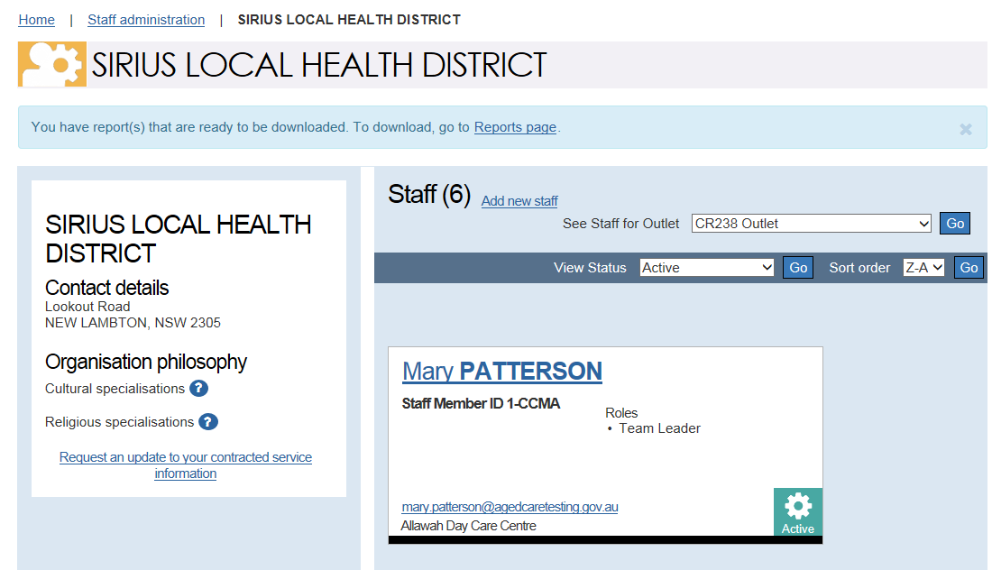
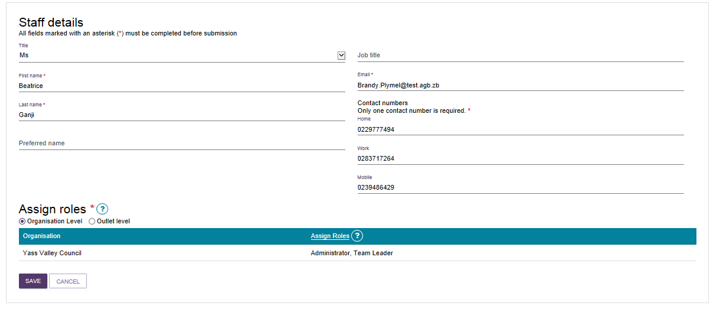
Administrator – Staff Administration
Hint: There is improved layout for staff administration and better distinction between organisation and outlet roles.

Slide 18
Supporting materials
The Summary of Changes document will be available prior to 24 July 2017 to reflect other changes to the portals
All user guides/quick reference guides are being updated with new screenshots and content.
Updated material will be available shortly on the Department of Health’s ‘Information for service providers’ page at: https://agedcare.health.gov.au/our-responsibilities/ageing-and-aged-care/programs-services/my-aged-care/information-for-service-providers

